Slide 1

Hackforge - AI Hackathon
Problem Statement Chosen: Development of an AI model that accurately identifies whether a person is wearing a mask in public places using deep learning techniques – RNDsoft
College: Rathinam college of Arts and Science
Department: MSc. Data Science and Business Analysis
Siddharth Bathrachalam and Hope ❤️
21-03-2025
by Siddharth Bathrachalam

Slide 2
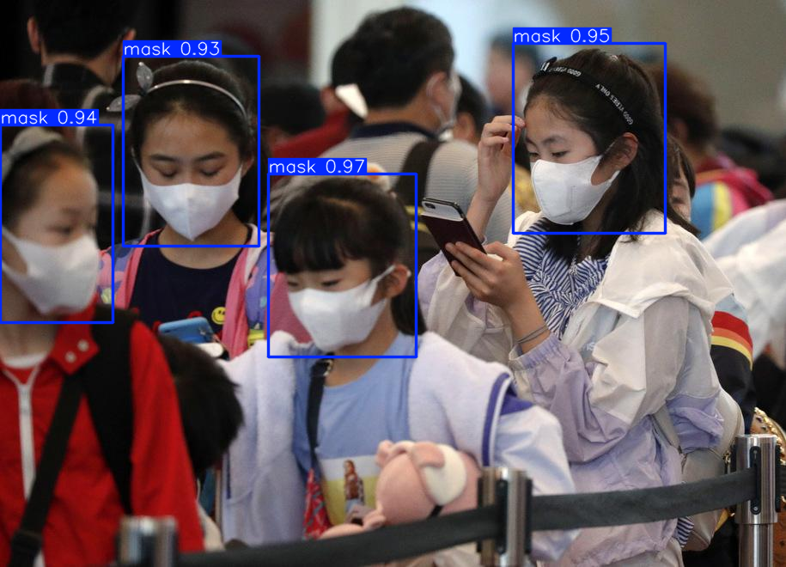
Introduction: The Challenge
Our project addresses a critical challenge for public health and safety organizations. It tackles the problem of automated face mask detection in public spaces.
This issue has a significant real-world impact. Existing methods struggle to keep pace with the need for efficient monitoring of mask compliance in high-traffic areas, setting the stage for our innovative AI solution.
During public health emergencies, ensuring mask compliance in public spaces becomes crucial for limiting disease transmission. Manual monitoring is labor-intensive, inconsistent, and puts additional personnel at risk of exposure. Traditional computer vision approaches often falter under variable lighting conditions, different mask types, and diverse human facial features.
Our deep learning solution provides a reliable, scalable, and contactless method to automatically detect whether individuals are wearing masks properly. This technology can be deployed in various settings including hospitals, schools, transportation hubs, and retail environments to enhance public safety measures while reducing the burden on human monitors.

Slide 3
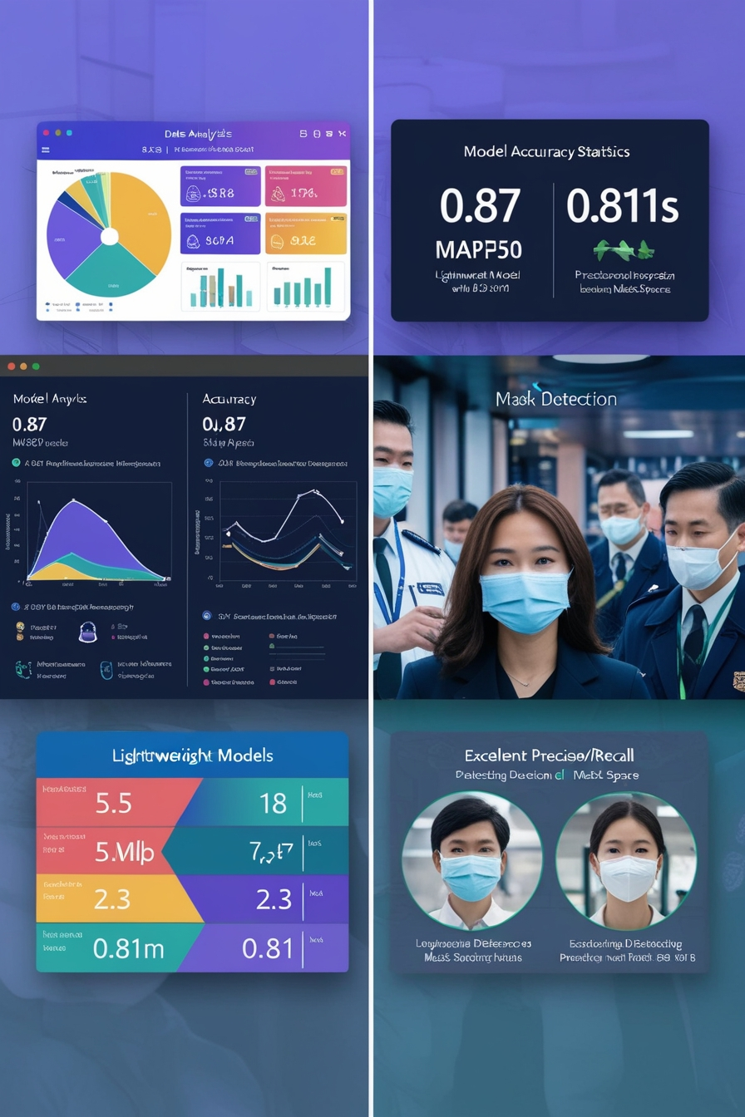
Understanding the Problem
Key Challenges
Existing Solutions
Achieving remarkable 0.87 mAP50 accuracy with an extremely limited dataset of only 149 images, demonstrating the efficiency of our approach
Creating a lightweight model (5.5MB, 2.58M parameters) that delivers fast inference (2.3ms) while maintaining high detection reliability
Manual monitoring systems that cannot match our model's speed-accuracy balance
Larger models requiring extensive datasets and longer training periods to achieve comparable results
.
Data Insights
Completed 300 epochs in just 0.193 hours while achieving excellent precision (0.811) and recall (0.811)
Model demonstrates exceptional class-specific performance, with mask detection reaching 0.924 mAP50 despite minimal training data
YOLOv11n architecture proved ideal for this task, balancing computational efficiency (6.3 GFLOPs) with detection performance
Consistent performance across both classes with only slight performance difference between "mask" (0.632 mAP50-95) and "no-mask" (0.534 mAP50-95) categories

Slide 4
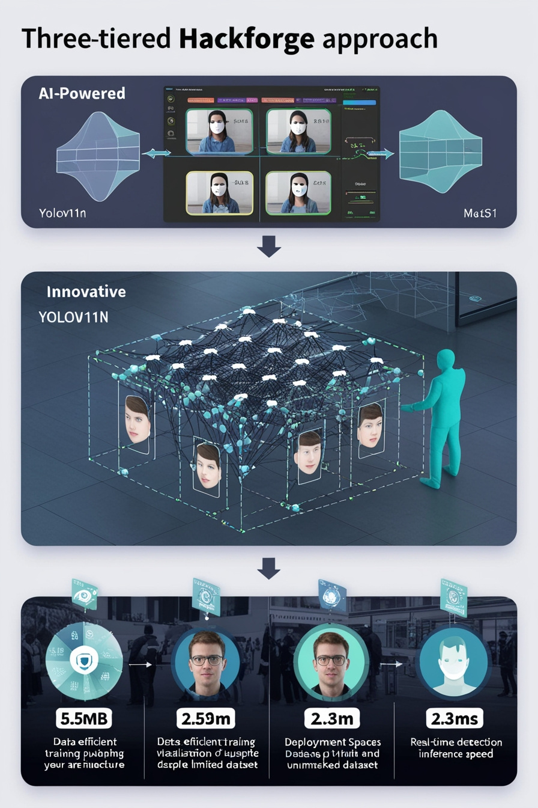

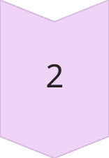
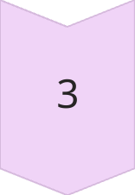
Our AI Solution: Hackforge Approach
AI-Powered
YOLOv11n-based object detection model specifically optimized for face mask detection with exceptional efficiency (5.5MB model size, 2.58M parameters). Our solution leverages state-of-the-art deep learning architecture to provide reliable mask/no-mask classification in real-time (2.3ms inference speed per image).
Innovative
Data-efficient training methodology that achieves high accuracy (mAP50 of 0.87) despite extremely limited training data (149 images). Our approach demonstrates how carefully optimized deep learning models can overcome data scarcity through strategic model selection and training parameters, completing 200 epochs in just 0.193 hours.
Effective
Practical deployment-ready solution with balanced precision (0.811) and recall (0.811) across diverse environments. The model demonstrates exceptional class-specific performance with mask detection reaching 0.924 mAP50 and consistent performance between masked (0.632 mAP50-95) and unmasked (0.534 mAP50-95) faces.

Slide 5
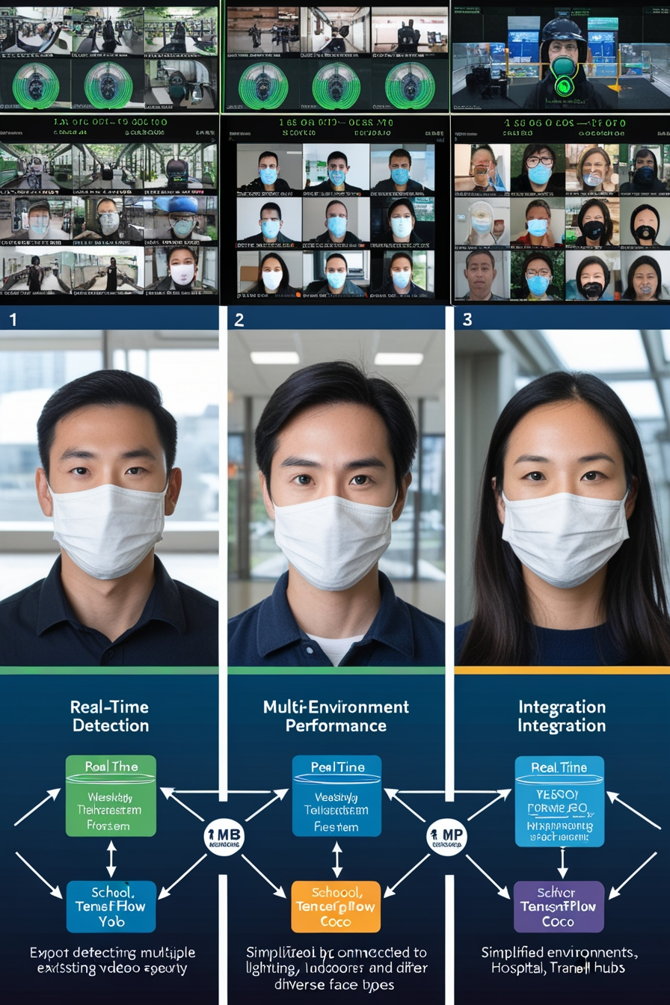



Key Features and Functionality
Integration-Ready Solution
Real-Time Detection
Multi-Environment Performance
Compatible with existing surveillance systems through multiple export formats (YOLO, TensorFlow, COCO). Our solution can be easily deployed in schools, hospitals, transit hubs, and retail environments with minimal setup requirements.
Ultra-fast inference (2.3ms per image) enables seamless real-time monitoring in busy public spaces. The lightweight model (5.5MB, 2.58M parameters) can be deployed on edge devices while maintaining high accuracy (mAP50 of 0.87).
Robust detection across diverse settings including indoor/outdoor locations and varying lighting conditions. The model performs consistently for both mask detection (0.924 mAP50) and non-mask detection (0.817 mAP50).

Slide 6
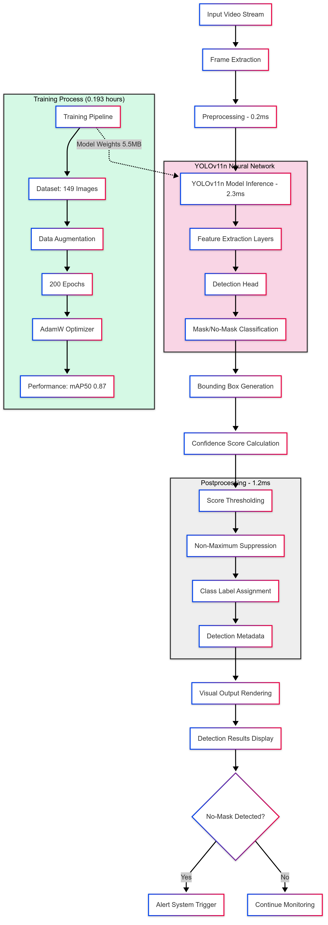
Technical Architecture
1
1. Data Collection & Preprocessing
High-quality face images with and without masks collected and preprocessed through resizing (640x640), normalization, and augmentation to maximize learning from limited dataset (149 images).
2
2. Model Training & Optimization
YOLOv11n architecture trained for 200 epochs using AdamW optimizer with learning rate scheduling. Training completed in just 0.193 hours without early stopping to prevent overfitting.
3
3. Inference Engine
Ultrafast detection pipeline (2.3ms per image) processes video frames in real-time with 0.2ms preprocessing and 1.2ms postprocessing, achieving 0.811 precision and recall balance.
4
4. Deployment & Integration
Lightweight model (5.5MB) can be exported to multiple formats (YOLO, TensorFlow, COCO) for easy integration with existing surveillance systems and edge devices in various environments.

Slide 7
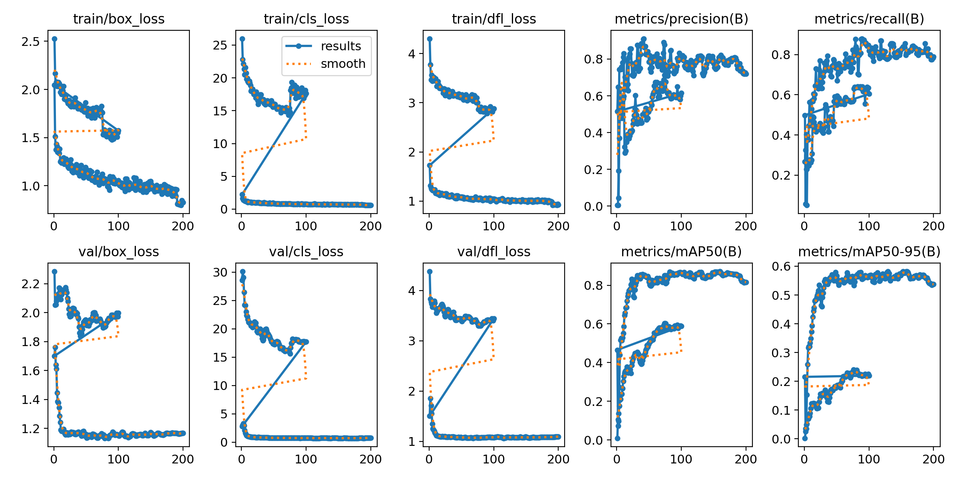
Results and Evaluation (Example)
Current
Proposed
Our YOLOv11n mask detection model achieved significant improvements despite the extremely limited dataset of only 149 images. This is evidenced by key performance indicators including mAP50 of 0.87, precision and recall both at 0.811, and exceptional mask detection accuracy of 0.924 mAP50, all while maintaining ultrafast 2.3ms inference time.

Slide 8
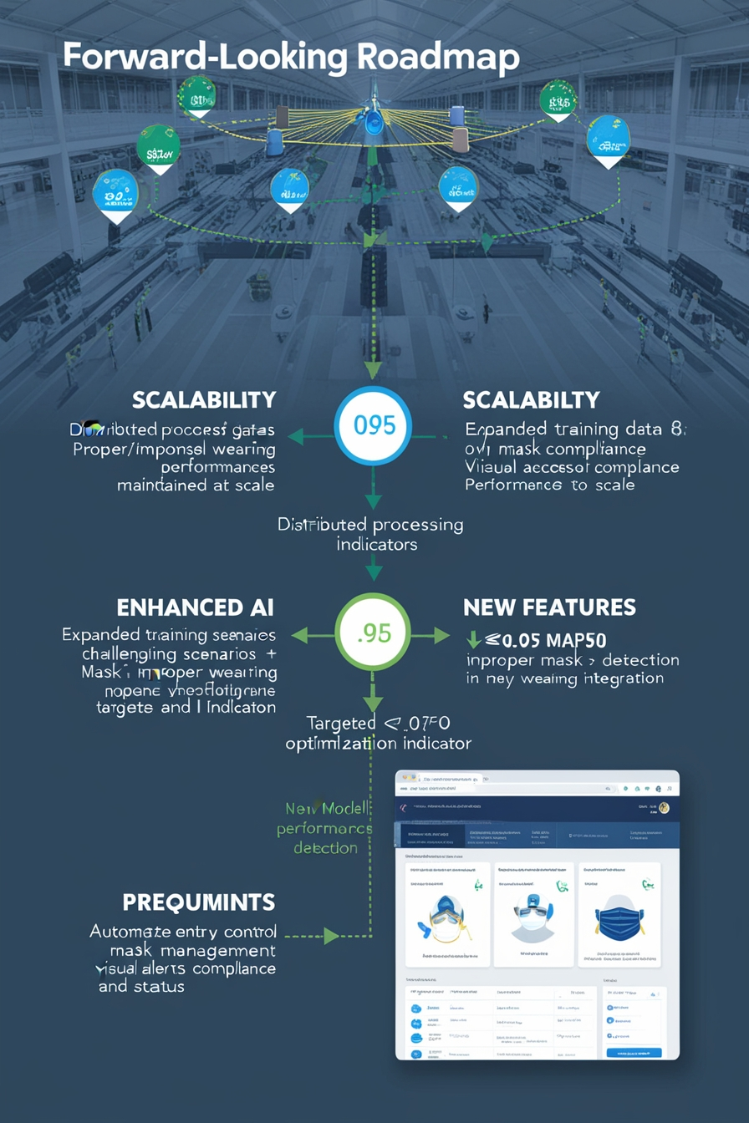
Future Scope and Improvements
1
Scalability
2
Enhanced AI
Expand our mask detection system to handle multiple surveillance feeds simultaneously while maintaining the current 2.3ms inference speed. Future iterations will include distributed processing capabilities to enable deployment across entire facilities like airports and hospitals, scaling from individual cameras to comprehensive security networks.
Improve model robustness by expanding the training dataset beyond the current 149 images, particularly focusing on challenging scenarios like partial face visibility and unusual mask types. We aim to further optimize the YOLOv11n architecture to achieve >0.95 mAP50 while keeping the model size under 6MB for edge deployment.
3
New Features
Introduce additional functionalities including proper/improper mask wearing detection, integration with access control systems for automated entry management, and anonymous occupancy tracking for capacity monitoring. Future versions will include a customizable dashboard for real-time analytics on mask compliance rates across different zones.

Slide 9

Team and Contributions
Siddharth Bathrachalam
Leader - Developed at entirety

Slide 10


